Slide 1

CMCS PowerPoint Presentation
PROG6212 Part 3 Final POE
Content:
Title: Contract Monthly Claim System (CMCS)
Subtitle: PROG6212 Part 3 - Final Portfolio of Evidence
Student Name:Grace Bissong Agbor
Student Number: ST10066225
Date: 12 January 2026
CMCS PowerPoint Presentation

Slide 2
Project Overview
Title:
System Overview
Content:
Purpose: Streamline lecturer contract claim management
Technology: ASP.NET Core 6.0 MVC + SQL Server
Key Innovation: Role-based access control with 4 user types
Highlights:
  Auto-calculation of claims
  Two-stage approval workflow
  Real-time status tracking
  PDF report generation

Slide 3
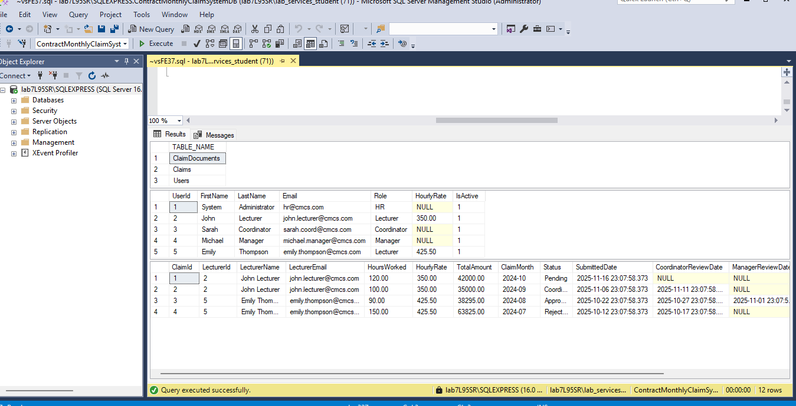
Slide 3: Changes from Part 2 to Part 3 (Page 1)
Title: Major Changes Based on Lecturer Feedback
Content:
1. HR Super User Implementation
✅ Added HR role with full system access
✅ HR creates all user accounts (NO registration)
✅ HR sets and updates lecturer hourly rates
✅ Complete user management dashboard
2. Auto-Calculation Feature
✅ Removed manual hourly rate input for lecturers
✅ Real-time calculation: Hours × Rate = Total
✅ Auto-populated name, surname, and rate
Database and Tables Created(SSMS), Screenshot Below

Slide 4
Slide 4: Changes from Part 2 to Part 3 (Page 2)
Title: Additional Enhancements
Content:
3. Validation Improvements
180-hour monthly maximum validation
Duplicate claim prevention per month
Required field validation
Email format validation
4. Entity Framework Integration
Database-first approach with SQL Server
No migrations required (as per marking center)
SQL script for database creation
Proper entity relationships

Slide 5
Slide 5: Key Feature - Session Management
Title: Session-Based Authentication
// SessionHelper.cs
public static void SetUserSession(ISession session,
int userId, string email, string role, string name)
{
session.SetInt32(UserIdKey, userId);
session.SetString(UserEmailKey, email);
session.SetString(UserRoleKey, role);
session.SetString(UserNameKey, name);
}
// Program.cs Configuration
builder.Services.AddSession(options =>
{
options.IdleTimeout = TimeSpan.FromMinutes(30);
options.Cookie.HttpOnly = true;
options.Cookie.IsEssential = true;
});
Explanation:
Secure session storage
30-minute timeout
HttpOnly cookies prevent XSS
Role-based page protection

Slide 6
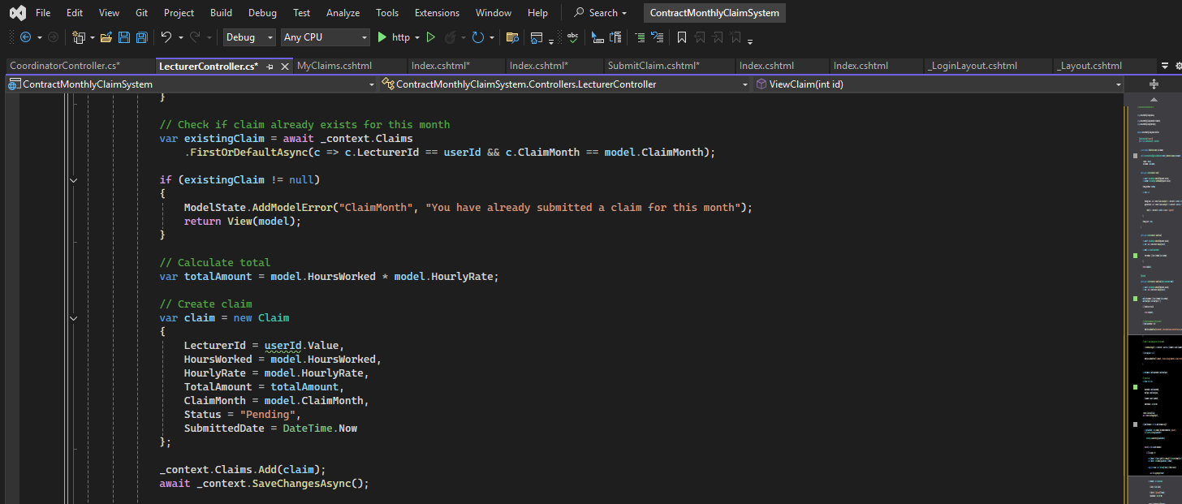
Slide 6: Key Feature - Auto-Calculation
Title: Automatic Claim Calculation
Code Screenshot &
Benefits:
Eliminates manual calculation errors
Consistent rate application
Real-time feedback to users

Slide 7
Slide 7: Key Feature - Two-Stage Approval
Title: Approval Workflow Implementation
Workflow Diagram:
Lecturer Submits Claim (Status: Pending)
↓
Coordinator Reviews (Stage 1)
├─ Approve → Status: CoordinatorApproved
└─ Reject → Status: Rejected (End)
↓
Manager Reviews (Stage 2)
├─ Approve → Status: Approved (Payment)
└─ Reject → Status: Rejected (End)
Code: // CoordinatorController.cs
[HttpPost]
public async Task<IActionResult> ApproveClaim(int id, string comments)
{
var claim = await _context.Claims.FindAsync(id);
claim.Status = "CoordinatorApproved"; // Stage 1
claim.CoordinatorReviewDate = DateTime.Now;
claim.CoordinatorComments = comments;
await _context.SaveChangesAsync();
// Forwarded to Manager
}
// ManagerController.cs
[HttpPost]
public async Task<IActionResult> FinalApproveClaim(int id, string comments)
{
var claim = await _context.Claims.FindAsync(id);
claim.Status = "Approved"; // Stage 2 (Final)
claim.ManagerReviewDate = DateTime.Now;
claim.ManagerComments = comments;
await _context.SaveChangesAsync();
// Ready for payment
}

Slide 8
Slide 8: Key Feature - PDF Report Generation
Title: Report Generation Using LINQ & iTextSharp

Slide 9
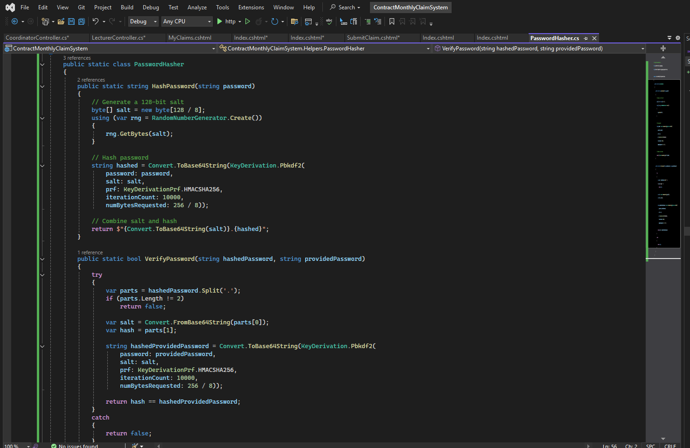

Slide 9: Security Implementation
Title: Security Features
Features:
PBKDF2 with 10,000 iterations
Unique salt per password
Role-based access control
Anti-forgery tokens
Password Hashing
public static string HashPassword(string password)
{
byte[] salt = new byte[16];
using (var rng = RandomNumberGenerator.Create())
rng.GetBytes(salt);
string hashed = Convert.ToBase64String(
KeyDerivation.Pbkdf2(
password: password,
salt: salt,
prf: KeyDerivationPrf.HMACSHA256,
iterationCount: 10000,
numBytesRequested: 32));
return $"{Convert.ToBase64String(salt)}.{hashed}";
}

Slide 10
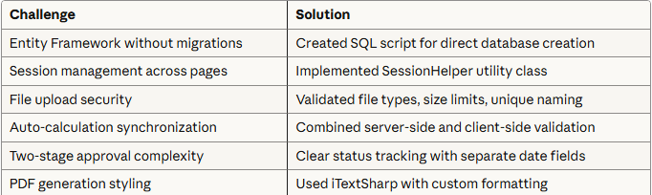
Slide 11: Challenges & Solutions
Title: Development Challenges
Lessons Learned:
Importance of clear requirements
Value of incremental testing
Benefits of separation of concerns
Need for comprehensive error handling

Slide 11
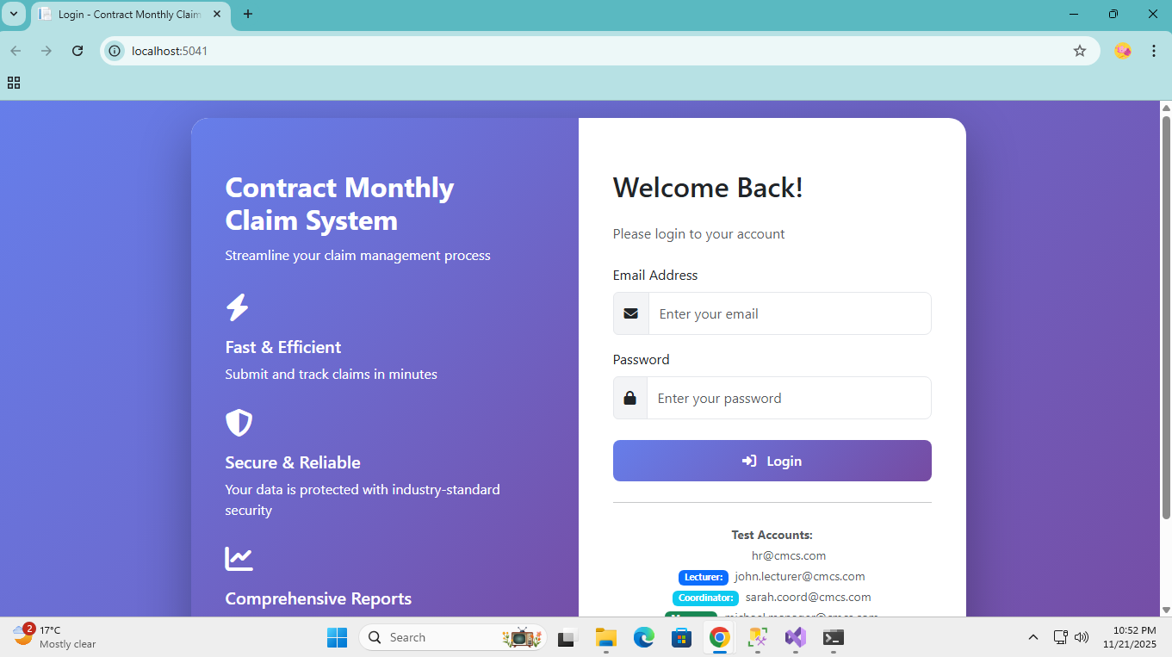
Slide 12: Testing & Quality Assurance
Title: Testing Approach
Content:
Test Scenarios Completed
✅ Complete claim workflow (submit → approve → paid) ✅ Rejection at both approval stages ✅ 180-hour validation enforcement ✅ Duplicate claim prevention ✅ Session timeout handling ✅ Unauthorized access attempts ✅ PDF generation with various filters ✅ File upload with different formats
Test Data
5 user accounts (4 roles)
4 sample claims (various statuses)
Multiple test documents

Slide 12
Slide 13: GitHub & Version Control
Title: Version Control Practices
Content:
Commit History (10+ commits)
Initial project structure setup
Database models and DbContext created
Authentication system implemented
HR user management added
Lecturer claim submission feature
Coordinator review functionality
Manager approval system
PDF report generation
UI/UX enhancements with Bootstrap
Validation and error handling
Documentation and README

Slide 13
Slide 14: Future Enhancements
Title: Potential Improvements
Content:
Planned Features
📧 Email notifications for status changes
📊 Advanced analytics dashboard
📱 Mobile responsive design
🔄 Bulk approval functionality
📅 Calendar integration
💾 Cloud storage for documents
🔍 Advanced search and filtering
📈 Trend analysis and forecasting
Technical Improvements
Implement distributed caching
Add API endpoints for mobile app
Enhance PDF styling
Add audit logging
Implement real-time notifications

Slide 14
Slide 15: Conclusion
Title: Project Summary
Content:
Project Achievements
✅ Fully functional claim management system ✅ All Part 3 requirements met ✅ Secure, scalable architecture ✅ Professional UI/UX design ✅ Comprehensive documentation ✅ Thorough testing completed
Technical Skills Demonstrated
ASP.NET Core MVC development
Entity Framework Core
SQL Server database design
Session management
Role-based security
PDF generation
Git version control
Deliverables
✅ Complete source code on GitHub
✅ SQL database script
✅ README with setup instructions
✅ PowerPoint presentation
✅ Video demonstration (10-15 mins)
Thank you!

